Slide 1

MIS Reports For Virtual Machines Consumption

Slide 2

Introduction
Businesses use multiple cloud platforms to provision the compute infrastructure that is used to run their business applications.
These compute resources are essentially fulfilled by several virtual machines deployed at various locations
This gives rise to complex technology estates which need to be optimized at various levels such as CPU, disk, memory, power status and operating system.

Slide 3

Project Goals / Business Understanding
The Business would like to understand the utilization pattern of all the compute resources CPU, Memory and Disk across various cloud platforms that are in it’s portfolio at all its locations
The business would like to understand the distribution of virtual machines based on location
The business would like to understand the power status of virtual machines at all its locations
Future Scope:
To determine spending patterns for different locations and allocate budgets accordingly
To optimize the usage of compute resources with a view to save costs without impacting productivity
To optimize the power status of virtual machines with a view to save costs
Technology stack:
We have used Tableau to build the visualisations and the dashboard

Slide 4
Data Understanding
Data Source: Secondary Data
Dataset shape : observations 40000, features 41
Name of Feature | Description
Allocated_Disk | The amount disk space allocated to the Virtual Machine
CPU | Number of CPUs assigned to the Virtual Machine
Cloud | Name of the cloud service provider
Consumed_Disk | Amount of disk consumed by the Virtual Machine
ESX_Host_Cores | Total number of CPU cores available on the ESX host
ESX_Host_Threads | Number of process threads that each CPU can handle

Slide 5
Data Understanding Continued…
Name of Feature | Description
Free_Disk | Amount of free disk space on the Virtual Machine
MEM | Amount of Memory allocated to the Virtual Machine
Max_Disk | Maximum amount of disk that can be used the Virtual Machine
Operating_System | Name of the operating system installed on the Virtual Machine
Site | Geographical site/location of the Virtual Machine
Status | Power status of the Virtual Machine
We have not used the data from the remaining columns in the dataset as these are not relevant to the project objective.

Slide 6
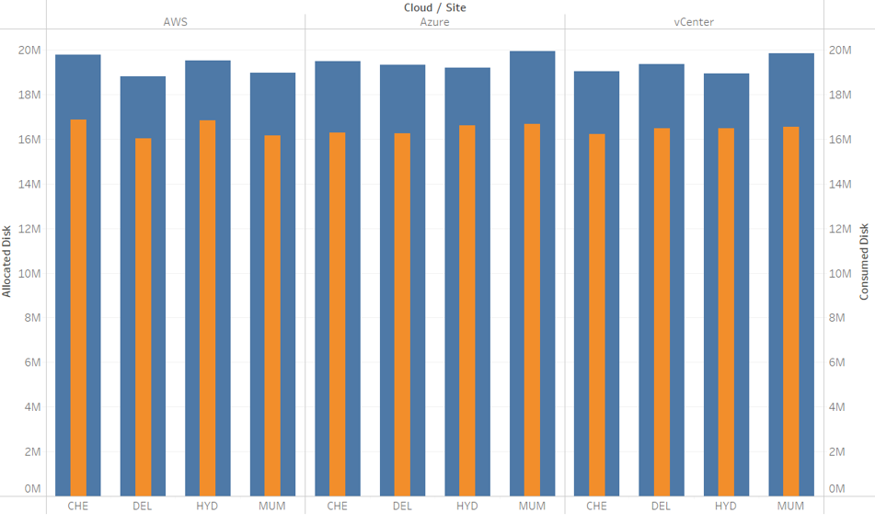

Allocated Vs Consumed disk for each cloud platform at site
This bar graph shows the total amount of allocated disk and consumed disk for each site broken down for each cloud platform.

Slide 7
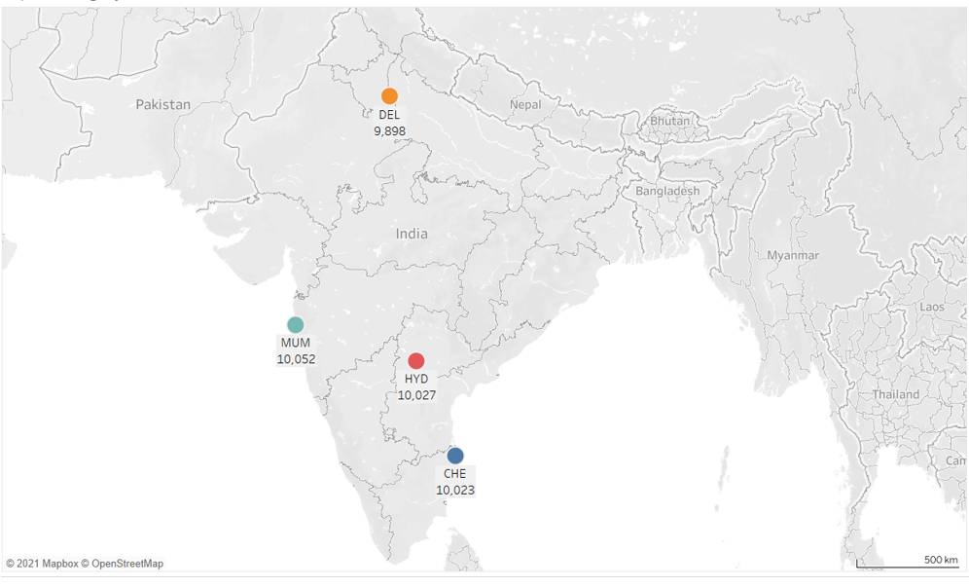
Number Virtual Machines per site
This map shows the total number of virtual machines hosted at each location.

Slide 8
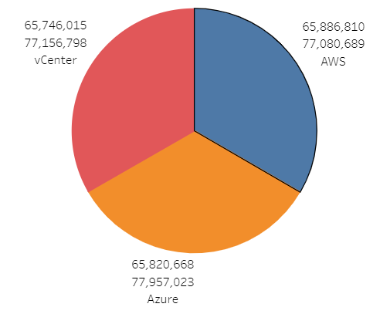

Consumed Disk and Allocated disk by each Cloud
This pie chart shows the total amount of consumed disk and the total amount of allocated disk for each cloud platform.
The smaller number is the consumed disk and the larger number is the allocated disk.

Slide 9
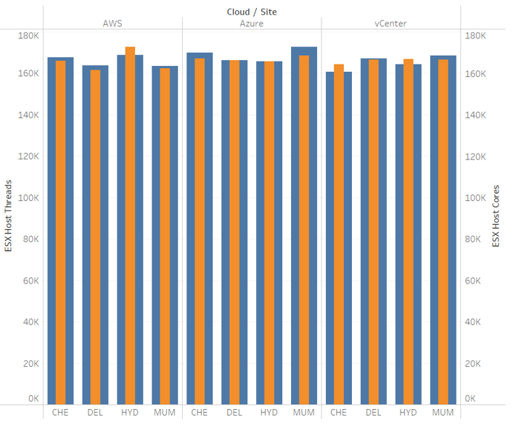

CPU Cores and Threads assigned
This bar graph shows the total number of CPU cores and threads assigned to each cloud platform at each site.

Slide 10
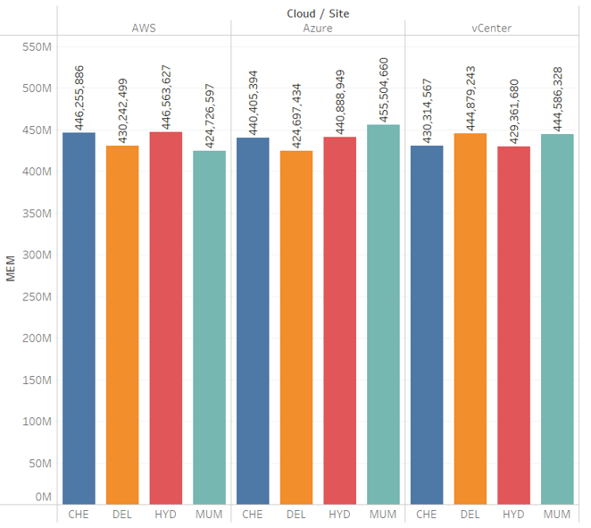
Memory Allocated to each cloud platform at each site
This bar graph shows the total amount of memory allocated to each cloud platform at each site

Slide 11
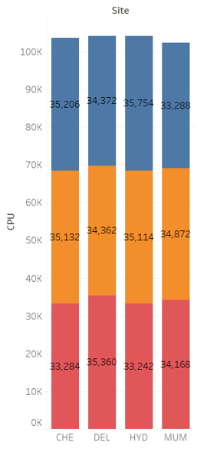

CPUs assigned to each cloud platform at each site
This stack bar shows the total number of CPUs
assigned to each cloud platform at each site

Slide 12
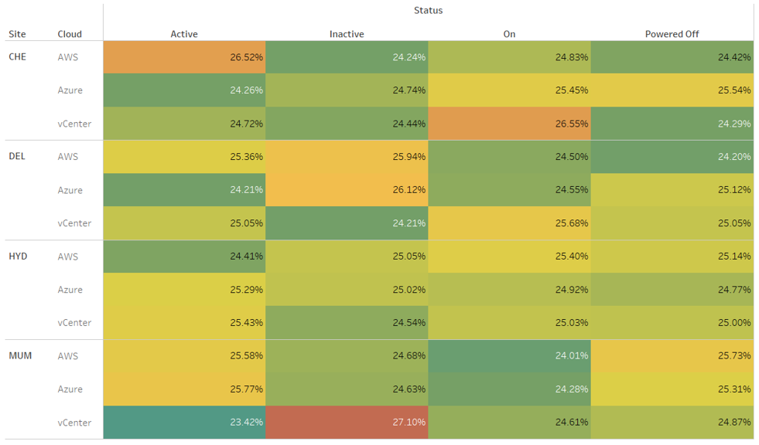

Virtual Machine status by cloud platform at each site
This text table shows the status of virtual machines on each cloud platform at each site as a percentage

Slide 13
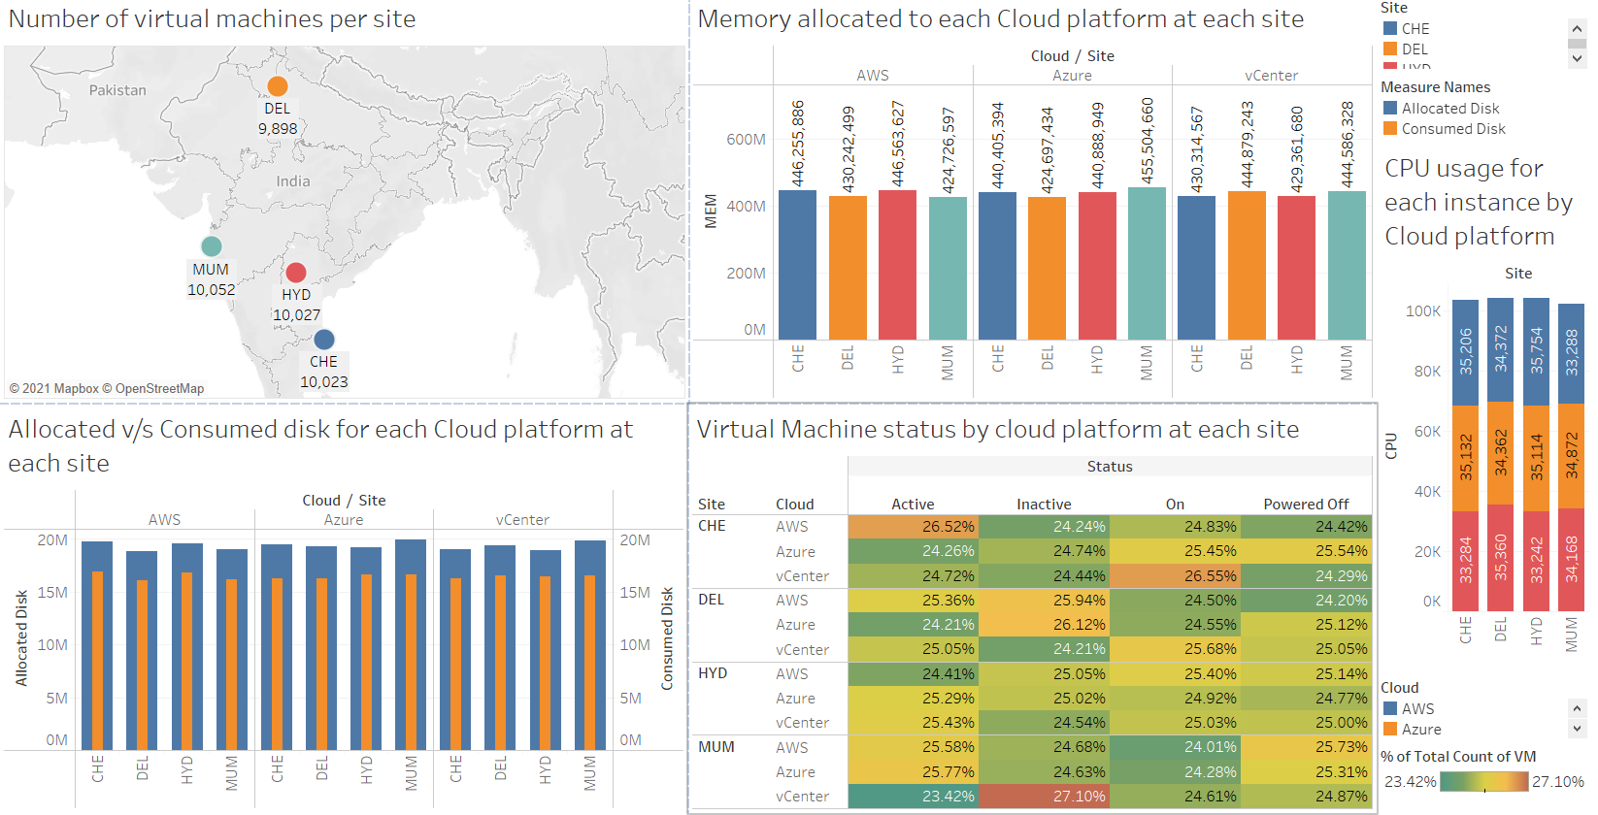
Dashboard
This is the collated dashboard showing all the different visualisations.

Slide 14
Conclusion
There is considerable amount of free disk available across the estate
The site with the highest number of Virtual Machines is Mumbai which hosts 10052 virtual machines
The maximum amount of disk has been allocated to Azure virtual machines, disk allocated is 77,957,023 GB
The maximum amount of disk is being consumed by AWS virtual machines, disk consumed is 65,886,810 GB
The maximum number of ESX host cores are allocated to virtual machines on AWS in Hyderabad, the number is 172842
The maximum number of ESX host threads are consumed by virtual machines on Azure in Mumbai, the number is 172657
The maximum amount of memory is allocated to virtual machines on AWS in Hyderabad, it is 446563627 MB
The maximum number of CPUs are allocated to virtual machines on AWS in Hyderabad, the number is 35754

Slide 15
Conclusion continued…
Virtual Machine power status percentages
Minimum active : vCenter Mumbai : 23.42%
Maximum active : AWS Chennai : 26.52%
Minimum inactive : vCenter Delhi : 24.21%
Maximum inactive : vCenter Mumbai : 27.10%
Minimum on : AWS Mumbai : 24.01%
Maximum on : vCenter Chennai : 26.55%
Minimum powered off : AWS Delhi : 24.20%
Maximum powered off : AWS Mumbai : 25.73%

Slide 16


